Slide 1
Participant Instructions
CAT Task 2018

Slide 2
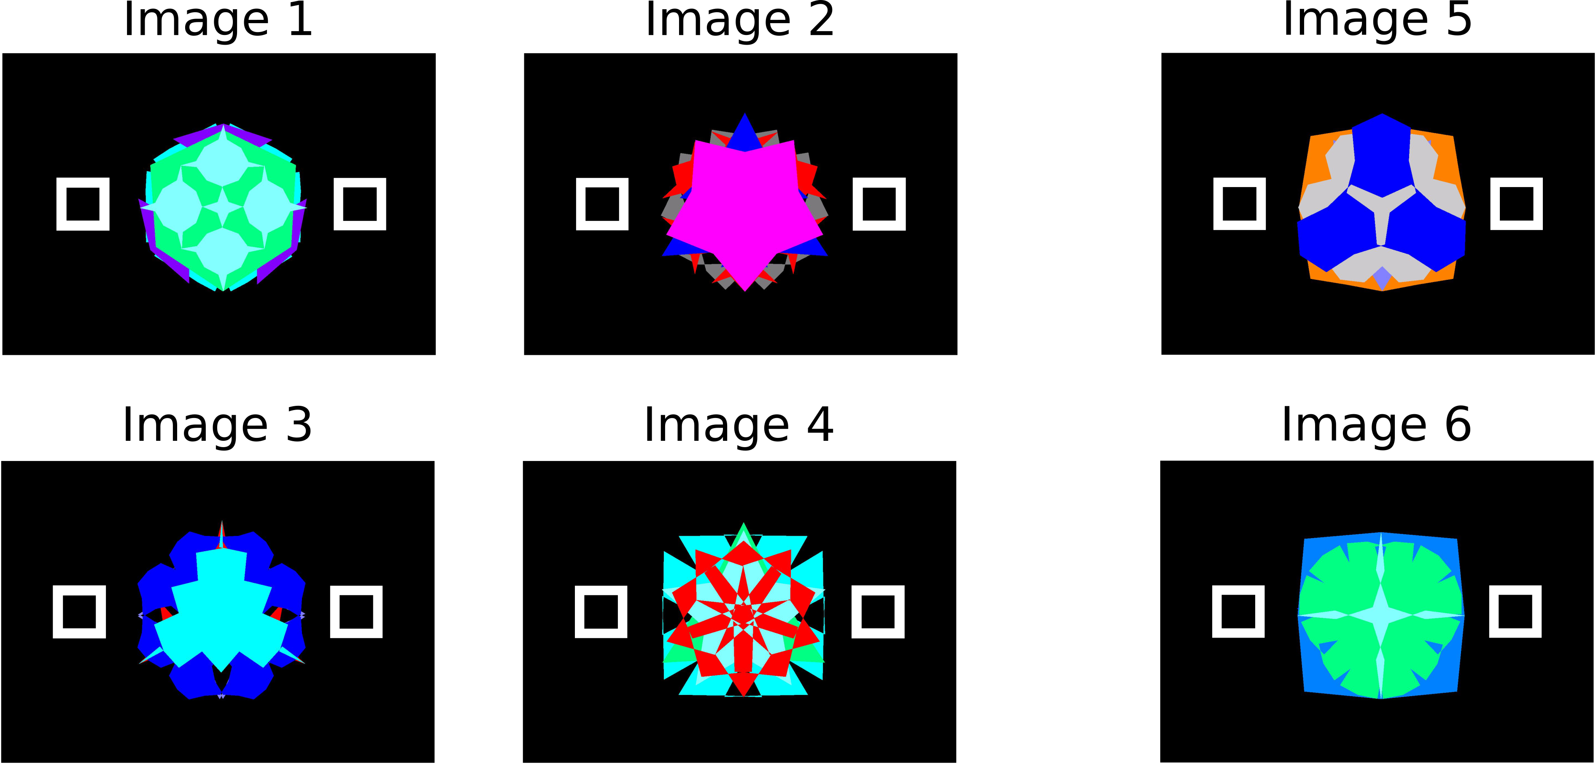
You will be presented with 6 unique images, one at a time, over multiple trials

Slide 3
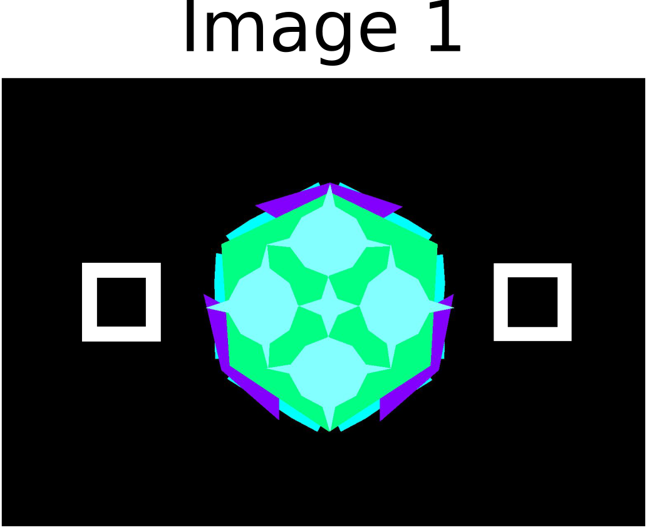
Your job is to figure out which box goes with each image

Slide 4


Select one of the two boxes using either the 1 or 2 key

Slide 5
You will learn which boxes go with each image through trial and error…
You will learn which boxes go with each image through trial and error… so take a guess!

Slide 6


If you are correct… you’ll see a green “yes”:
If you are wrong… you’ll see a red “no”:

Slide 7

4 of the 6 images will go with the same box every time you see them

Slide 8
2 will go with the LEFT box
2 will go with the
RIGHT box

Slide 9
The other 2 images are special… the right answer will depend on which image came before
There are 2 ways the image that came before can affect the answer for the special images…

Slide 10
Effect #1: The right answer will be the opposite of the image that came before… let’s see special Image 5

Slide 11
Effect #1: Now let’s see special Image 6

Slide 12
Effect #2: The right answer will be the same as the image that came before… let’s see special Image 5

Slide 13
Effect #2: Now let’s see special Image 6

Slide 14
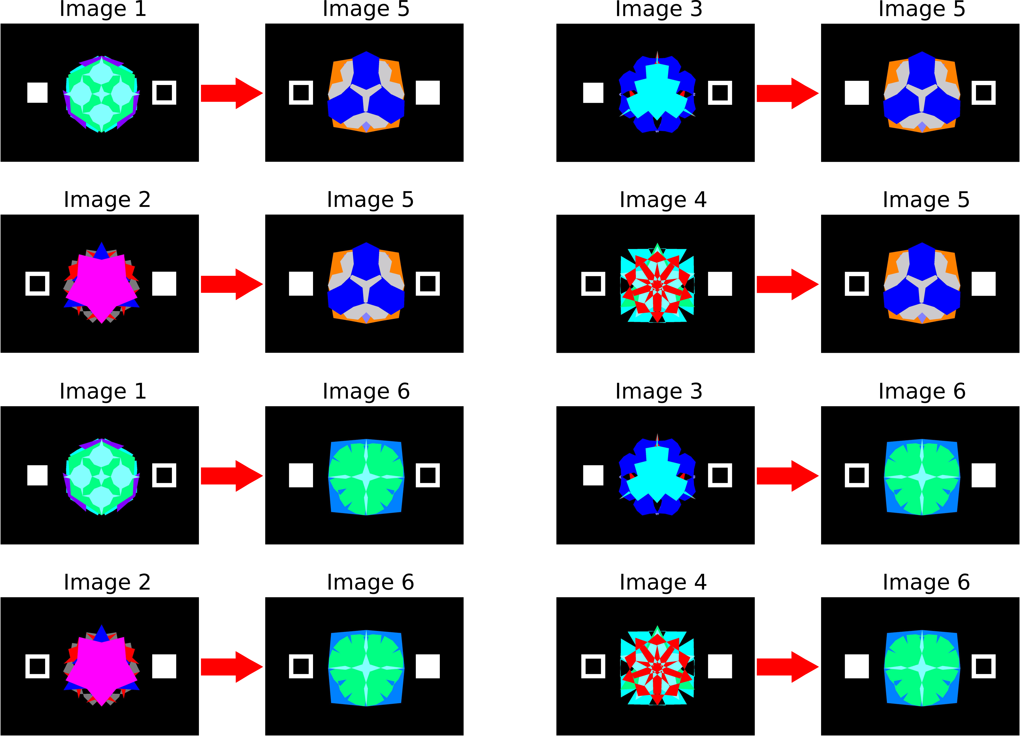
That means you will learn 4 direct relationships between the images and their correct box…
… and 8 relationships between the image that came before and the correct box for the special image

Slide 15
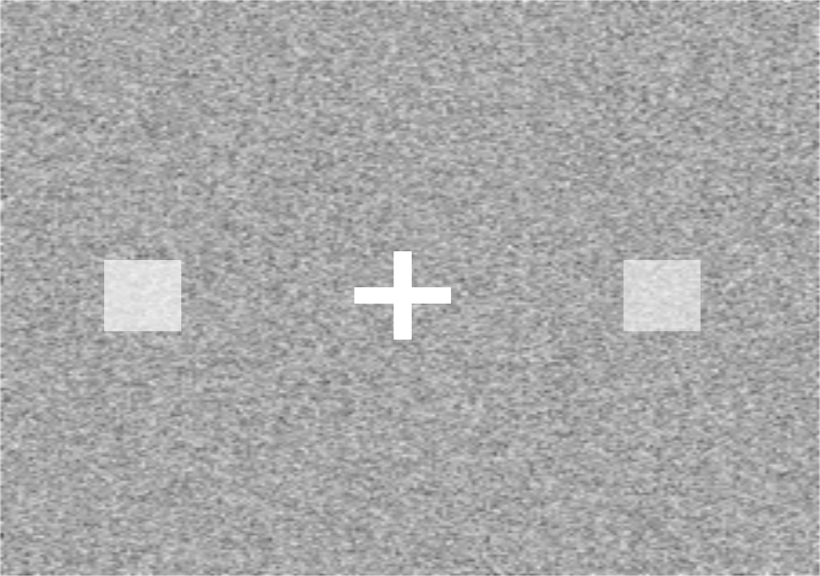
Sometimes you will see a different kind of trial… it will look like this:
Your job is to select the brighter box…

Slide 16
The box you select will turn bright white

Slide 17
When each trial begins, you will see this… the cross shows you where to look. Watch closely!
+

Slide 18
Next the image or static background will appear and stay on the screen for 1 second

Slide 19
It will then disappear and you will hold for a bit
+

Slide 20

When the “Go!” message appears, it’s time to press the button
Go!

Slide 21


If you are correct… you’ll see this:
If you are wrong… you’ll see this:
No!

Slide 22
If you do not respond within 1 second… you will see a white question mark.
?
?

Slide 23
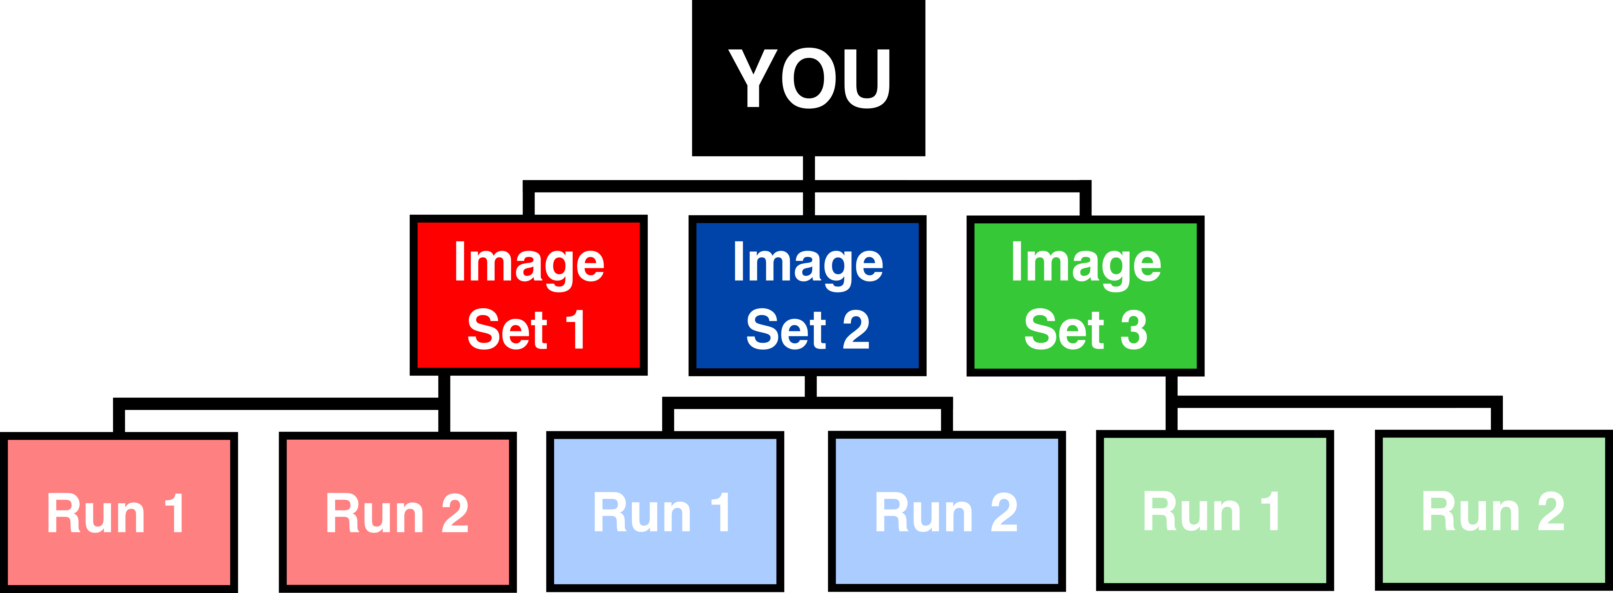
You will get to take a break between every run and image set. It’s a good time to go to the bathroom or get a drink!
The task will take about an hour. 3 image sets will be broken into 2 runs each

Slide 24
Do you have any questions about what you need to do?

